Slide 1

Learning Invariants for Software Reliability and Security
Pranav Garg
University of Illinois at Urbana-Champaign
March 6, 2015

Slide 2
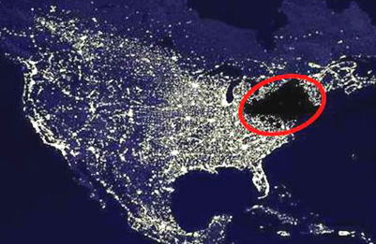


Bugs are bad. Bugs in critical software are worse!
2003 Power Outage
Loss > 6B USD
BMW security patch
> 2M vehicles
Heartbleed bug
> 0.5M websites
“We had in excess of three million online operational hours
in which nothing had ever exercised that bug.
I'm not sure that more testing would have revealed it”
“We had in excess of three million online operational hours
in which nothing had ever exercised that bug.
I'm not sure that more testing would have revealed it”
- Mike Unum, GE Energy
This talk: verifying critical software
for provable security and reliability

Slide 3



Success stories in software verified for security and reliability
Compcert
secure L4 microkernel
integrity, confidentiality,
reliability
Compiler verified wrt
C semantics
ExpressOS @ UIUC
secure mobile OS
Hypervisor and Verve OS
isolation and type safety
integrity, isolation,
secure storage, UI isolation, …
Drawbacks: Huge manual effort is typically required
Goal of my research: Reduce manual effort significantly by automating key steps in verification

Slide 4
How does one verify software?
Inductive Invariant
Reach
Init
I
Bad
State space
Steps to verify software:
1. Specify an invariant.
2. Validate the invariant:
- includes Init
- excludes Bad
- is inductive
Main bottleneck to
automatic verification
Manual →
Simple properties → Automatic
Complex properties → Manual

Slide 5

Invariant Synthesis
Validating Invariants
CAV 14*
PLDI 13
Data-structures
Natural Proofs
SAS 13
CAV 13*
Sequential s/w
Machine learning
OOPSLA 14
TACAS 11
Concurrent, Distributed systems
Finitary reductions
Concurrent s/w
Sequentializations
ICSE 13
ISCA 11
Memory errors/leaks
Test generation
Transient faults
Application checkpointing
*Invited to journals FMSD and JACM

Slide 6
Outline
Invariant synthesis for:
Sequential software
Machine learning for synthesizing invariants
A new learning model ICE for invariant synthesis
Machine learning algorithms in the ICE model
Applications: ExpressOS, GPU Kernels, …
Concurrent and distributed systems
Event-driven protocols
Responsiveness of Windows Phone USB driver
Cloud systems (ongoing work)
(replicated data stores/Cassandra/Riak)

Slide 7
Software Verification 101
int i;
void increment(int n)
// Requires: (n >= 0);
{
i = 0;
while (i < n)
{
i = i + 1;
}
return;
}
// Ensures: i == n;
Step 1. Specify an invariant
// Loop invariant: i <= n
Step2. Validate the invariant:
Includes Init:
Excludes Bad:
Is inductive:

Slide 8
ExpressOS fragment: Cache of DiscPages
class CachePageHolder { // this.Head is a sorted list of CachePages
CachePage Head; // Class invariant: sorted(this.Head);
. . .
CachePage LookupPrev(int k) {
// Ensures: (ret != NULL => ret.Key <= k);
// Ensures: (ret != NULL && ret.Next != NULL) =>
ret.Next.Key > k;
CachePage current = Head, prev = null;
while (current != null && current.Key <= k) {
prev = current; current = current.Next;
} return prev;
}
. . .
}

Slide 9
ExpressOS fragment: Cache of DiscPages
class CachePageHolder { // this.Head is a sorted list of CachePages
CachePage Head; // Class invariant: sorted(this.Head);
. . .
CachePage LookupPrev(int k) {
// Ensures: (ret != NULL => ret.Key <= k);
// Ensures: (ret != NULL && ret.Next != NULL) =>
ret.Next.Key > k;
CachePage current = Head, prev = null;
while (current != null && current.Key <= k) {
prev = current; current = current.Next;
} return prev;
}
. . .
}

Slide 10
ExpressOS fragment: Cache of DiscPages
class CachePageHolder { // this.Head is a sorted list of CachePages
CachePage Head; // Class invariant: sorted(this.Head);
. . .
CachePage LookupPrev(int k) {
// Ensures: (ret != NULL => ret.Key <= k);
// Ensures: (ret != NULL && ret.Next != NULL) =>
ret.Next.Key > k;
CachePage current = Head, prev = null;
while (current != null && current.Key <= k) {
prev = current; current = current.Next;
} return prev;
}
. . .
}

Slide 11
ExpressOS fragment: Cache of DiscPages
class CachePageHolder { // this.Head is a sorted list of CachePages
CachePage Head; // Class invariant: sorted(this.Head);
. . .
CachePage LookupPrev(int k) {
// Ensures: (ret != NULL => ret.Key <= k);
// Ensures: (ret != NULL && ret.Next != NULL) =>
ret.Next.Key > k;
CachePage current = Head, prev = null;
while (current != null && current.Key <= k) {
prev = current; current = current.Next;
} return prev;
}
. . .
}
// Loop invariant:
sorted(this.Head) && ((prev == null && Head ->* current) ||
(Head ->* prev && current == prev.Next && prev.Key <= k));

Slide 12
Learning invariants: Solution 1
Not robust for
invariant generation
Invariant
Good
Bad
State space
Boolean classifier

Slide 13
Learning invariants: Solution 2
Labeled sample set
s₁: +
s₂: -
s₃: +
…
Verification Oracle
Program + Spec
Learner
Verifier
checks hypothesis
Invariant
Hypothesis H?

Slide 14
Counter-example: Positive
H
Good
Bad
New positive
counter-example

Slide 15
Counter-example: Negative
New negative
counter-example
Good
Bad
H

Slide 16
What happens if the invariant is not inductive?
H
Good
Bad
s₁
s₂
and
Don’t know whether these states should be included in the
invariant or not.
All we know:

Slide 17
ICE: Learning invariants using Implication Counter-Examples
([Garg et al. CAV 14], Invited to JACM)
ICE sample set
s₁ → s₂
s₃ → s₄
s₅ → s₆
s₇: +
s₈: -
s₉: +
…
Verification Oracle
Program + Spec
Learner
Verifier
checks hypothesis
Invariant
Hypothesis H?
New learning model for robust synthesis of invariants

Slide 18
Learning an invariant given an ICE sample
x₁ -10
x₁ – x₂ -2
Variable x₂
20
x₁ – x₂ -2
0
-20
-40
x₁
-10
-60
-40
-20
0
Variable x₁
Program State Space

Slide 19
Learning invariants using decision trees
Input space:
Class of Invariants: Arbitrary Boolean functions over linear
inequalities
where
is a program variable
yes
no
yes
no
yes
no

Slide 20
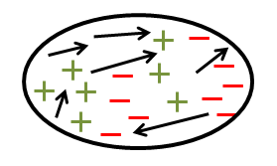
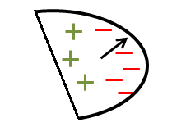
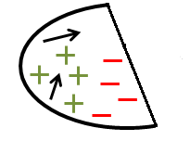
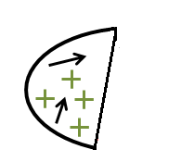
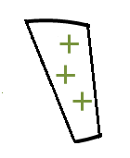
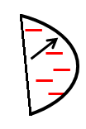

Learning decision trees given an ICE sample
Attribute
[Garg et al. 2015]
Entropy-based choice of
attributes in (+,-) case:
[Quinlan 1986]
Theorem [Garg et al. 2015]:
The above algorithm always produces a decision tree that
is consistent with the input ICE sample.

Slide 21
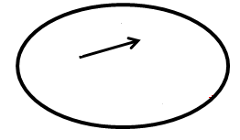
Choosing the best attribute
[Garg et al. 2015]
Measure 1: Extends Shannon entropy and Information Gain
to implications using probabilistic dependencies
is the root of
S₁
S₂
where: p, n, i is the number of positive points,
negative points and implications in S
Measure 2: Penalize implications “cut” by attribute

Slide 22
Some Invariants Learned
Benchmark programs:
from literature and software competitions
Are ~ 20-80 LOC
Invariants are involved:
Arbitrary Boolean
functions
Large constants

Slide 23
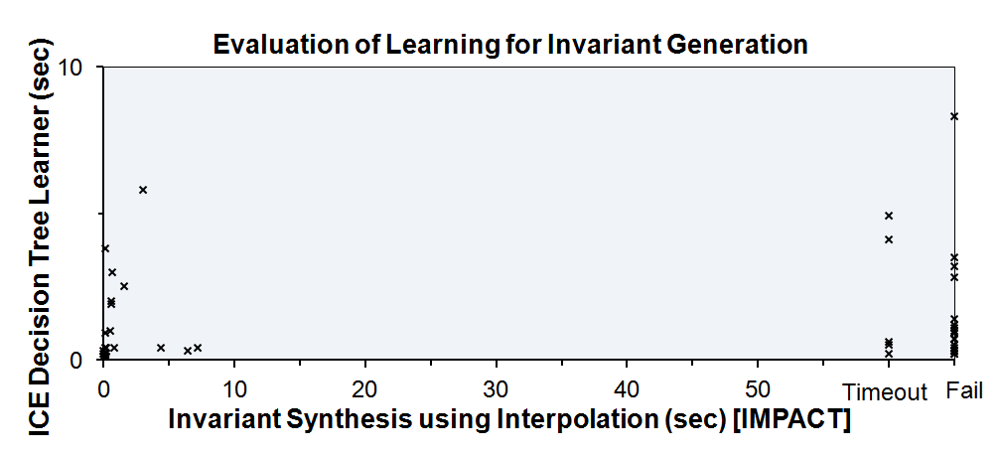
Results
Invariant Synthesis using Interpolation [IMPACT] | ICE Decision Tree Learner
Only 28/55 programs | All programs! < 10 seconds

Slide 24


GPUVerify
(ongoing work)
Verifies GPU kernels for data-race freedom
Converts the kernel to a non-deterministic sequential program
Synthesizes conjunctive invariant that imply race freedom
Decision tree learner gives 3x-5x speedup.
Scales to larger kernels.
Verify kernels that require disjunctive
invariants.
Race-freedom
Parallel GPU
kernels
Nondet.
Seq. programs
Assertions

Slide 25
ExpressOS fragment: Cache of DiscPages
class CachePageHolder { // this.Head is a sorted list of CachePages
CachePage Head; // Class invariant: sorted(this.Head);
. . .
CachePage LookupPrev(int k) {
// Ensures: (ret != NULL => ret.Key <= k);
// Ensures: (ret != NULL && ret.Next != NULL) =>
ret.Next.Key > k;
CachePage current = Head, prev = null;
while (current != null && current.Key <= k) {
prev = current; current = current.Next;
} return prev;
}
. . .
}
// Loop invariant:
sorted(this.Head) && ((prev == null && Head ->* current) ||
(Head ->* prev && current == prev.Next && prev.Key <= k));

Slide 26
Learning data-structure invariants ([Garg et al. CAV 13*, SAS 13, CAV 14], *Invited to FMSD)
Program configuration → explicit array and list contents
Properties are typically quantified.
Quantified Data Automata (QDA) for representing such
quantified formulas
Developed ICE learning algorithms for QDAs
Head
5
7
8
9
sorted
Head
y₁
y₂
y₁.Key <= y₂.Key

Slide 27
Results
Some Invariants Learned | Interpolation [ABGRS12] | ICE
 | <2s | <2s
 | Timeout | <2s
 | <2s | <2s
 | Timeout | <2s
 | Fail | 5s
 | Fail | <2s
 | Fail | <2s

Slide 28
System Architecture
(LLVM)
Java
C/C++
C#
.NET
ICE sample
Boogie
Invariant generation
using ICE
(scalars, arrays, lists)
Z3 (SMT solver)
Invariant H?
Verification
Oracle
Learner

Slide 29
Outline
Invariant synthesis for:
Sequential software
Machine learning for synthesizing invariants
A new learning model ICE for invariant synthesis
Machine learning algorithms in the ICE model
Applications: ExpressOS, GPU Kernels, …
Concurrent and distributed systems
Event-driven protocols
Responsiveness of Windows Phone USB driver
Cloud systems (ongoing work)
(replicated data stores/Cassandra/Riak)

Slide 30
Event-driven protocols
OS, drivers
Schematic of
USB Hub Driver for
Microsoft Windows Phone
Device
Port
Device
Hub
Port
Device
Port
Hardware
Is the driver responsive?
Any received message must be handled or
explicitly deferred by the process.

Slide 31
Event-driven protocols: Infinite state space
Configuration:
ls: local state (finite)
q: FIFO incoming message buffers (unbounded)
q_{port}
q_{hub}
Port
error
state
Hub
q_{device}
Device

Slide 32
Almost Synchronous Invariants for
Event-driven protocols
[OOPSLA 14]
Almost synchronous invariants
Finite Invariants
Init
Bad
Reach
(infinite)
It is sufficient to enumerate states in ASIs
It covers checking for errors along trajectories that do not belong to ASIs

Slide 33
Verifying protocols using
Almost-Synchronous Invariants
[OOPSLA 14]
Testing
Verification
Event-driven protocols | LOC in P | Zing Model Checker |  | Almost-Synchronous Invariants
 |  | # states | Time (h:mm) | # states | Time (h:mm)
Elevator | 270 | 1.4 x 10⁶ | 0:22 | 2.8 x 10⁴ | 0:08
OSR driver | 377 | 3.1 x 10⁵ | 0:16 | 3.9 x 10³ | 0:02
Truck Lifts | 290 | 3.3 x 10⁷ | 2:07 | 1.1 x 10⁵ | 0:24
Time Sync (Linear Topo) | 2200 | 7.4 x 10¹⁰ | 5:34 | 1.0 x 10⁷ | 3:07
German cache coherence | 280 | >1 x10¹² | >10:00 | 4.7 x 10⁸ | 2:32
Windows Phone USB Driver | 1440 | >1 x10¹² | >10:00 | 2.4 x 10⁹ | 3:48

Slide 34
Verifying protocols using
Almost-Synchronous Invariants
[OOPSLA 14]
Testing
Verification
Event-driven protocols | LOC in P | Zing Model Checker |  | Almost-Synchronous Invariants
 |  | # states | Time (h:mm) | # states | Time (h:mm)
Elevator | 270 | 1.4 x 10⁶ | 0:22 | 2.8 x 10⁴ | 0:08
OSR driver | 377 | 3.1 x 10⁵ | 0:16 | 3.9 x 10³ | 0:02
Truck Lifts | 290 | 3.3 x 10⁷ | 2:07 | 1.1 x 10⁵ | 0:24
Time Sync (Linear Topo) | 2200 | 7.4 x 10¹⁰ | 5:34 | 1.0 x 10⁷ | 3:07
German cache coherence | 280 | >1 x10¹² | >10:00 | 4.7 x 10⁸ | 2:32
Windows Phone USB Driver | 1440 | >1 x10¹² | >10:00 | 2.4 x 10⁹ | 3:48

Slide 35


Verifying distributed systems (Ongoing)
Eventual consistency in replicated data stores
Hinted-handoff
Read-repair protocols
Model systems as a non-deterministic
sequential program
specifying eventual consistency
specifying invariants that imply
this property
Eventual
consistency
Model of
distributed
system
Nondet.
Seq. program
Assertions

Slide 36
Invariant Synthesis
Validating Invariants
CAV 14*
PLDI 13
Data-structures
Natural Proofs
SAS 13
CAV 13*
Sequential s/w
Machine learning
OOPSLA 14
TACAS 11
Concurrent, Distributed systems
Finitary reductions
Concurrent s/w
Sequentializations
ICSE 13
ISCA 11
Memory errors/leaks
Test generation
Transient faults
Application checkpointing
*Invited to journals FMSD and JACM

Slide 37







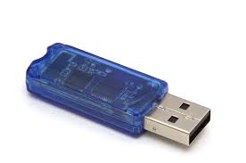

Future Plans
Building automatic verification technology for
building reliable and secure software
Generic properties:
information flow security,
memory safety, data-race freedom
responsiveness, …
Properties need not be specified by the developers →
completely automatic tools
and techniques.
Develop machine learning
algorithms targeted to these
properties.
ExpressOS

Slide 38
Future Plans
Building automatic verification technology for
building reliable and secure software
Deep properties:
integrity, confidentiality, isolation,
availability, data consistency, …
Developers specify these properties
Refine these high level properties to code
Introduce auxiliary state to establish the correspondence
Alleviate the burden on the user by synthesizing code level properties.
ExpressOS

Slide 39
Future Plans
Verified systems is finally within reach.
Automating verification by reducing the
manual burden will pave way for verified software.
Make software verification
as ubiquitous as software testing.
Thank you!

